Slide 1
Principles of Geometric Forms
Minahil Qazi
Department of Architecture

Slide 2
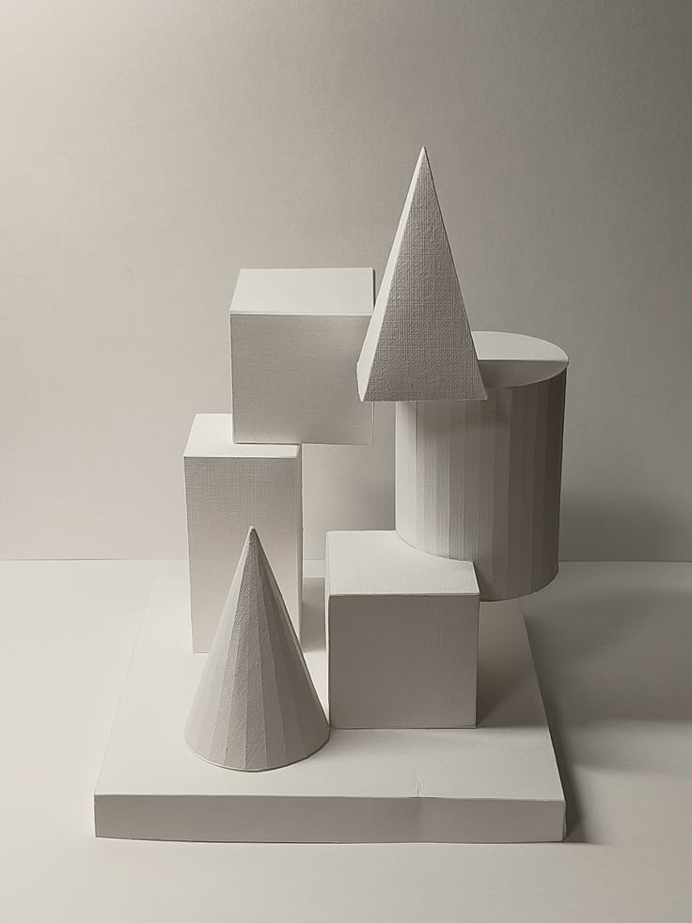
Introduction to Platonic Solids
•Basic three-dimensional geometric forms
•All faces are identical and evenly arranged
•Each corner connects the same number of faces
•Known for symmetry, balance, and order
•Used in design to study form and spatial structure

Slide 3
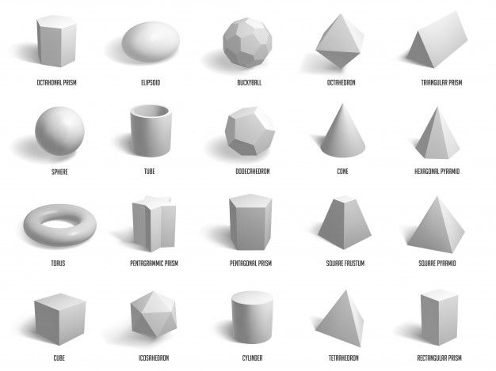
Types of Platonic Solids
Tetrahedron:
by 4 triangular faces; the simplest and most basic solid.
Cube (Hexahedron):
Made of 6 square faces; represents stability and balance.
Octahedron:
Consists of 8 triangular faces; a symmetrical and evenly distributed form.
Dodecahedron:
Composed of 12 pentagonal faces; complex yet highly ordered.
Icosahedron:
Has 20 triangular faces; known for its smooth and rounded appearance.

